Slide 1
Adaptive Learning

Slide 2
Learning
Learning is any process by which a system improves performance from experience.

Slide 3
Why is machine learning necessary?
learning is a hallmark of intelligence; many would argue that a system that cannot learn is not intelligent.
without learning, everything is new; a system that cannot learn is not efficient because it rederives each solution and repeatedly makes the same mistakes.
Why is learning possible?
Because there are regularities in the world.

Slide 4
Defining the Learning Task
Improve on task, T, with respect to
performance metric, P, based on experience, E.
T: Playing checkers
P: Percentage of games won against an arbitrary opponent
E: Playing practice games against itself
T: Recognizing hand-written words
P: Percentage of words correctly classified
E: Database of human-labeled images of handwritten words
T: Driving on four-lane highways using vision sensors
P: Average distance traveled before a human-judged error
E: A sequence of images and steering commands recorded while
observing a human driver.
T: Categorize email messages as spam or legitimate.
P: Percentage of email messages correctly classified.
E: Database of emails, some with human-given labels

Slide 5
Types of training
Supervised learning: uses a series of labelled examples with direct feedback
Reinforcement learning: indirect feedback, after many examples
Unsupervised/clustering learning: no feedback
Semisupervised

Slide 6
Which of these things is NOT like the others?

Slide 7
Which of these things is like the others? And how?

Slide 8

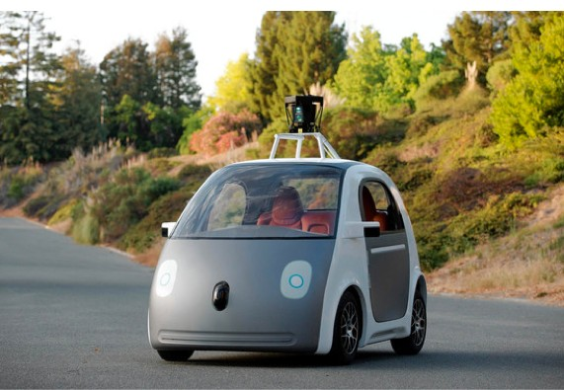
Driverless Vehicle
Learning to drive an autonomous vehicle
Associate steering commands with image sequences
Google Prototype
Task T: driving on public, 4-lane highway using vision sensors
Perform measure P: average distance traveled
Training E: sequence of images and steering commands recorded while observing a human driver

Slide 9
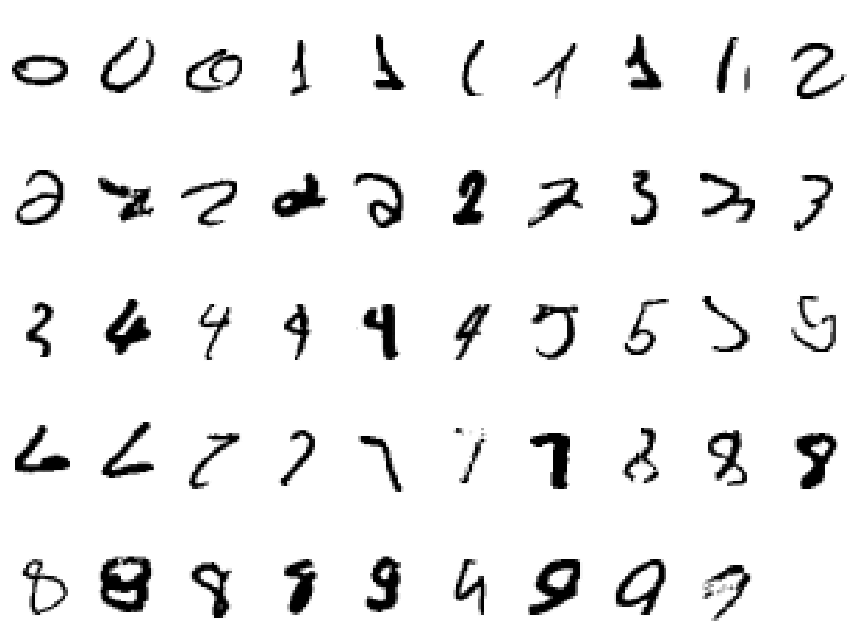
Handwritten character recognition
It is very hard to say what makes a “2”
Wide variability of same numeral
Handcrafted rules will result in large no of rules and exceptions
Better to have a machine that learns from a large training set

Slide 10








Face Recognition
Training examples of a person
Test images

Slide 11
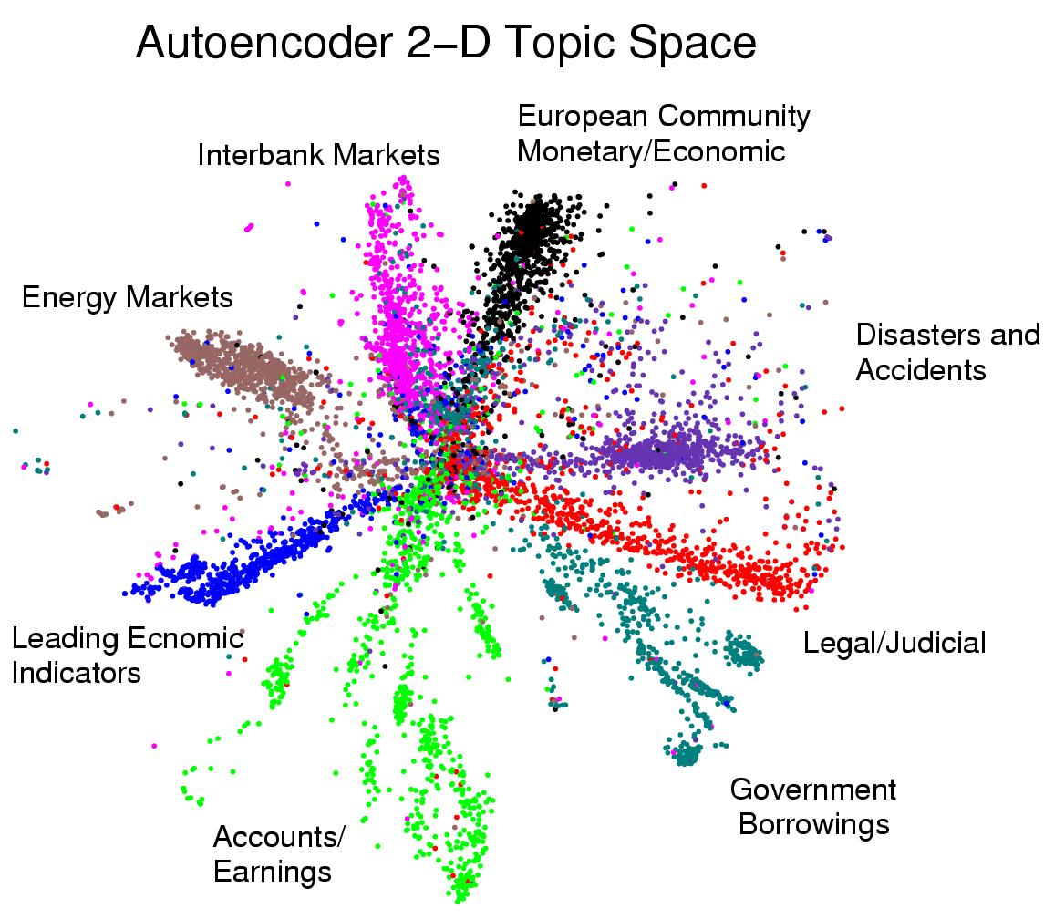
Displaying the structure of a set of documents

Slide 12
Example: Cancer Diagnosis
Application: automatic disease detection
Importance: this is modern/future medical diagnosis.
Prediction goal: Based on past patients, predict whether you have the disease
Data: Past patients with and without the disease
Target: Cancer or no-cancer
Features: Concentrations of various proteins in your blood

Slide 13
Example: Netflix
Application: automatic product recommendation
Importance: this is the modern/future shopping.
Prediction goal: Based on past preferences, predict which movies you might want to watch
Data: Past movies you have watched
Target: Like or don’t-like
Features: ?

Slide 14
Adaptive Learning
1st generation: Rules
Analyst creates rules - very time consuming and not very accurate, cannot adapt to new data
2nd generation: Simple machine learning
uses statistical methods to make decisions
3rd generation: Deep learning
learns more complex relationships between features. Automatically learns how to use combinations of features when making a decision.
4th generation: Adaptive learning

Slide 15
Adaptive Learning
An adaptive system is a set of interacting or interdependent entities, real or abstract, forming an integrated whole that together are able to respond to environmental changes or changes in the interacting parts.
Feedback loops represent a key feature of adaptive systems, allowing the response to changes;
Examples of adaptive systems include: natural ecosystems, individual organisms, human communities, human organizations, and human families.

Slide 16
Thank YOU

